Slide 1
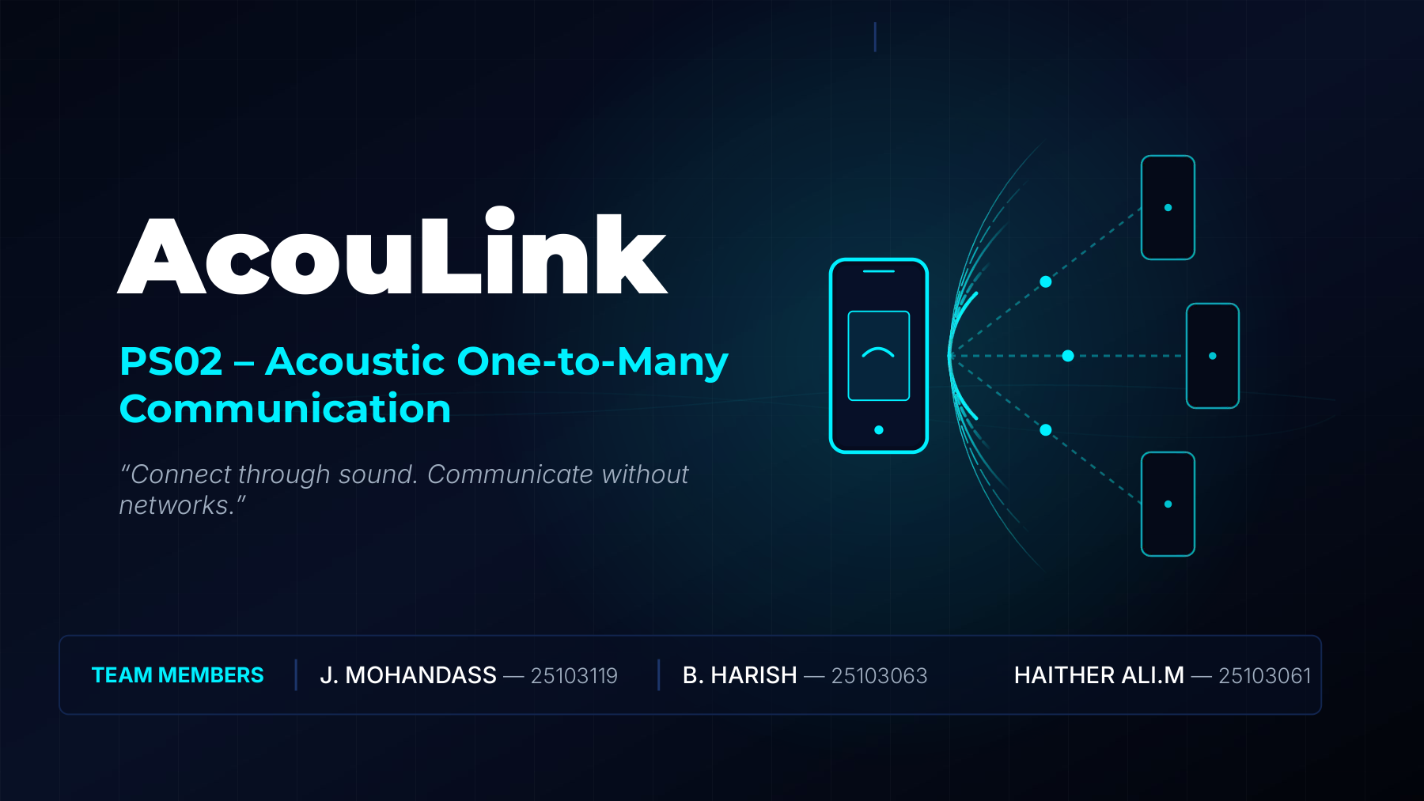

Slide 2
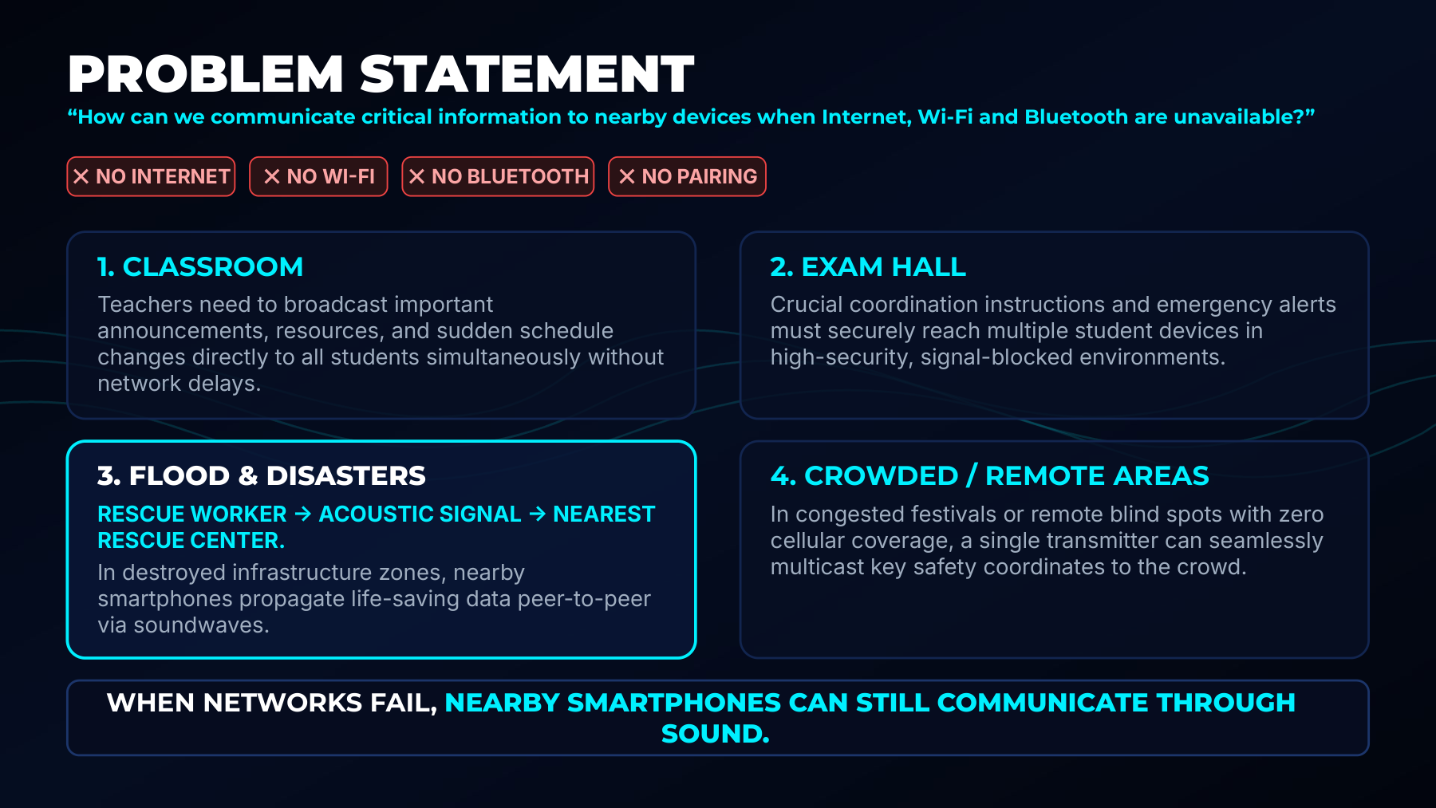

Slide 3
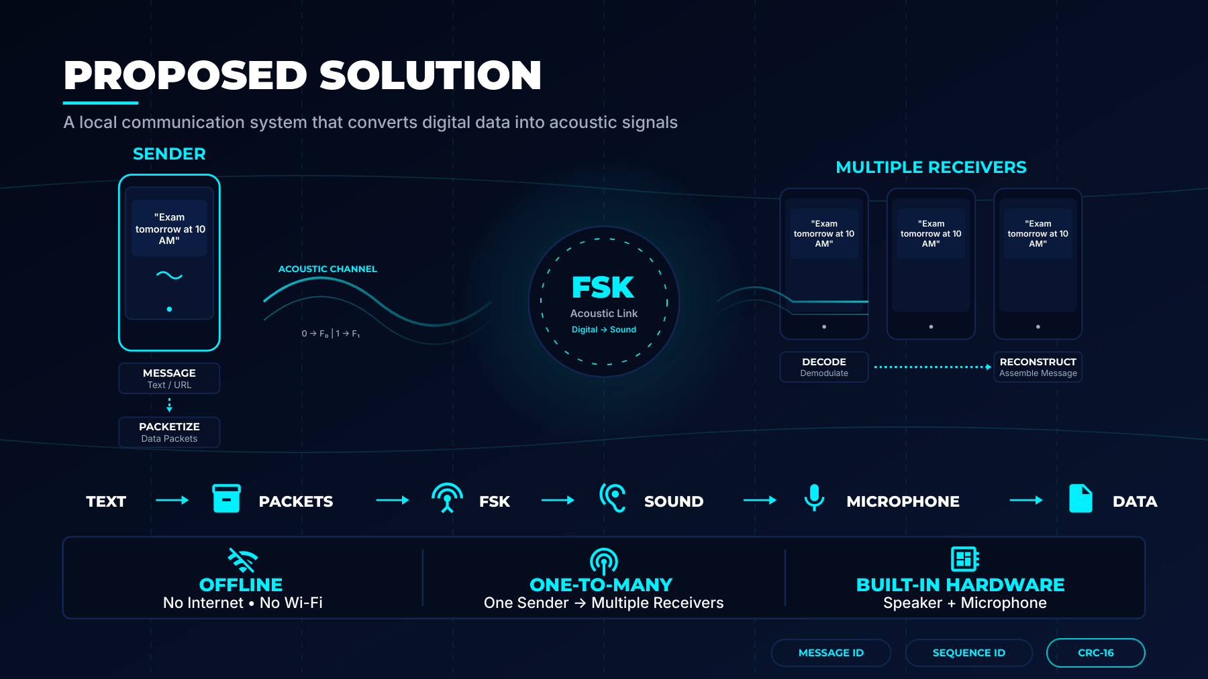

Slide 4
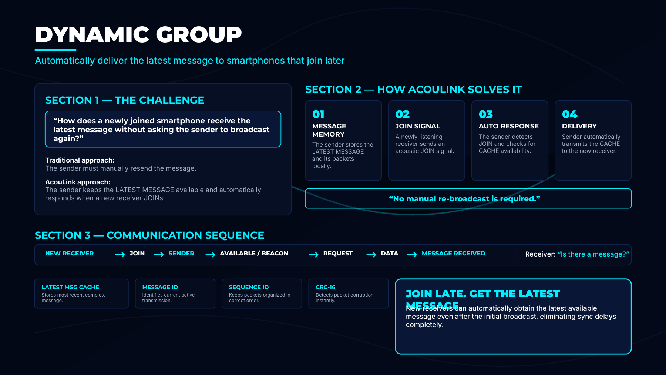

Slide 5
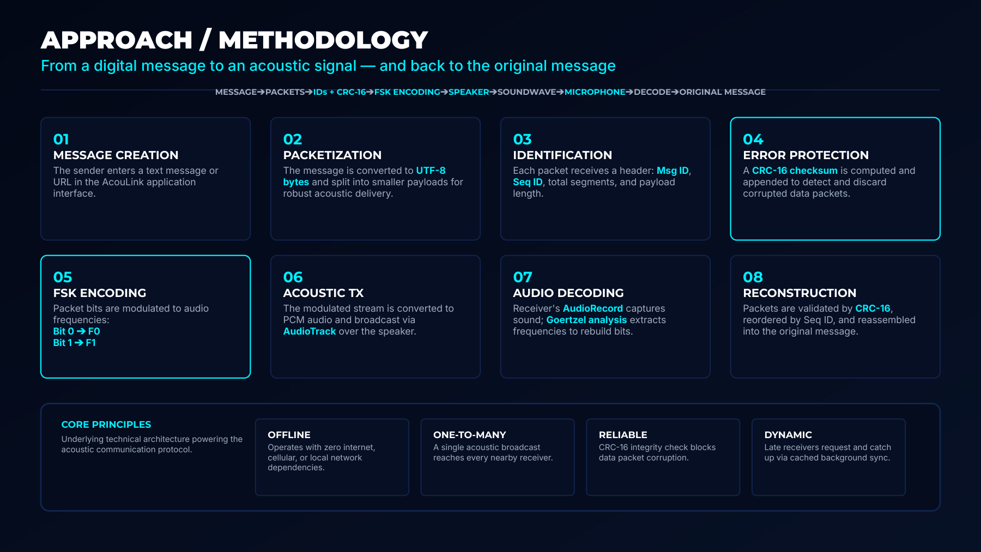

Slide 6
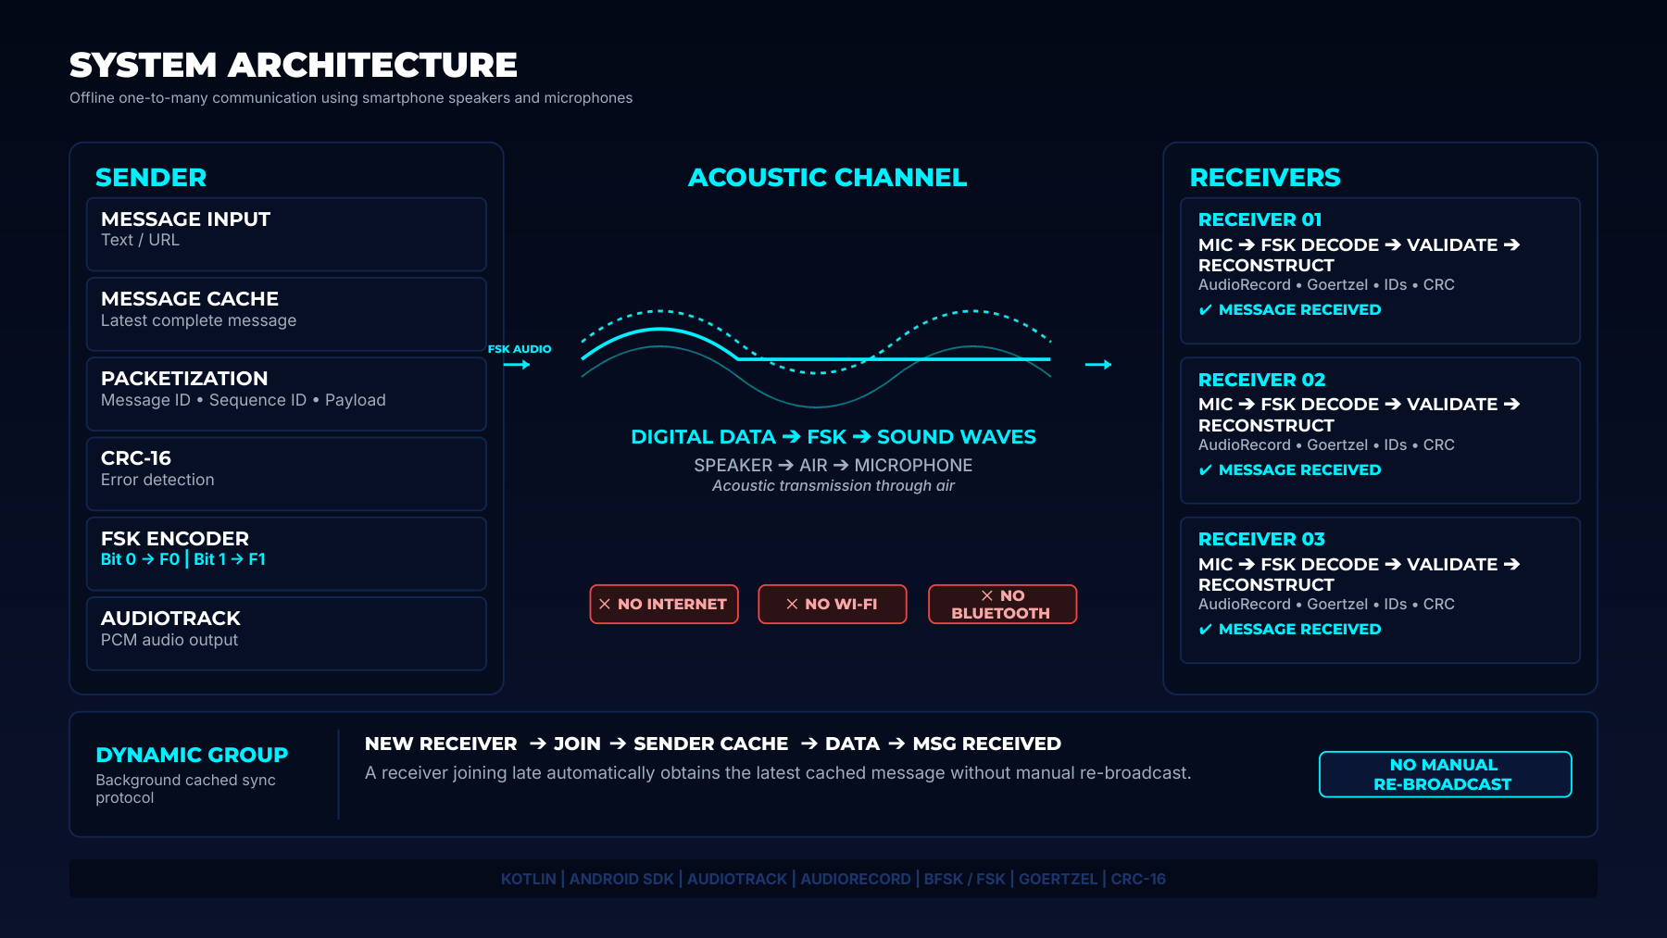

Slide 7
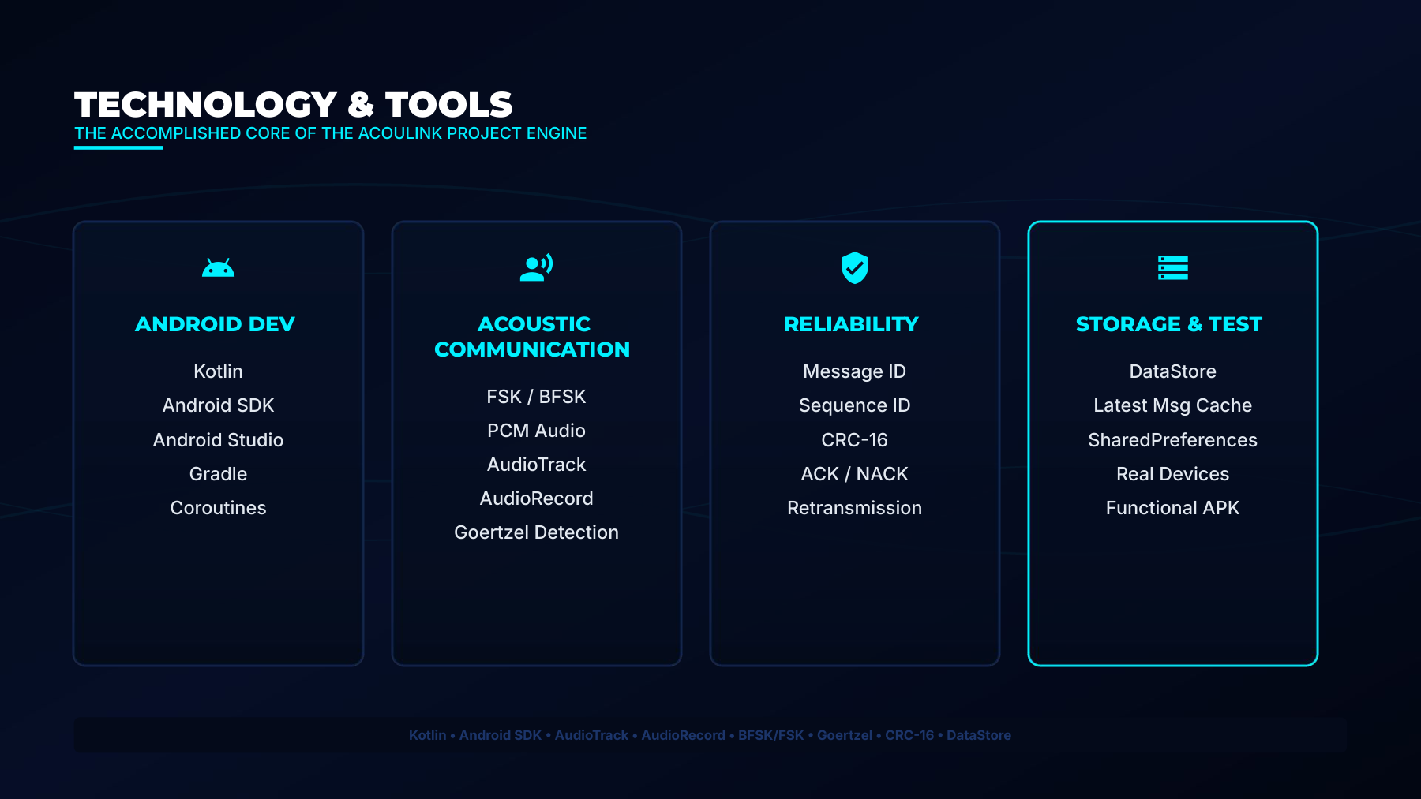

Slide 8







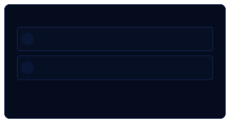









COMMUNICATION
PROTOCOL
ROBUSTACCOUSTICPACKETSTRUCTURE&RELIABILITY LAYER
ACOUSTIC PACKET STRUCTURE (FRAME FORMAT)
PREAMBLE
PACKET TYPE
MESSAGE ID
PROTOCOL VER
SEQUENCE ID
Sync Sequence
JOIN/DATA/ACK...
8-bitUniqueID
4-bit Version
8-bit Packet Index
TOTAL SEGMENTS
PAYLOAD LENGTH
PAYLOAD DATA
CRC-16
Total Packet Count
8-bitByteCount
Variable Message Bytes UTF8
Error Protection
SUPPORTED PACKET TYPES
RELIABILITY MECHANISMS
JOIN
Late-joining sync request
BEACON
REQUEST
1
MESSAGE ID
Specificsegment
Uniquelyidentifiesthe current active transmission session.
Periodic network presence
download
2
SEQUENCE ID
ACK
Successful delivery receipt
NACK
Corruptpacket retransmit ask
Maintainsstrictpacket order and tracks missing segments.
DATA
Activepacket payload
3
CRC-16 CHECKSUM
Instantlydetectsanddiscards corrupted acoustic signals.
PREAMBLE  PACKET TYPE  MESSAGE ID  SEQUENCE ID  CRC16  ACOULINK PROTOCOL ENGINE

Slide 9
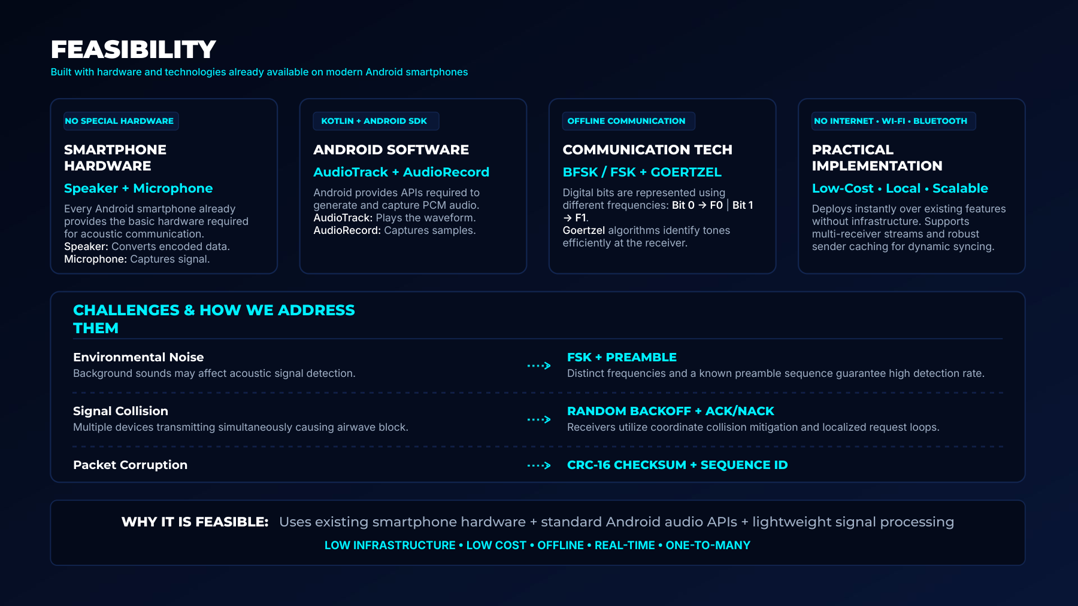

Slide 10

















FUTURE SCOPE
Fromacousticprototypetoresilient communication infrastructure

01 • OPTIMIZE
Better Acoustics

02 • ADAPT
Smarter Comms

03 • SCALE
Larger Groups

04 • DEPLOY
Real-World Use
TODAY
AcouLink Prototype
●
Improved synchronization
Higher
transmission
efficiency
Better range and reliability
●
Adaptive frequency selection
Improved noise
tolerance
Intelligent error
recovery
●
Efficient collision avoidance
Faster group
synchronization
Support for
massive
receivers
●
Emergency & local alerts
Classrooms &
campuses
Museums &
guided info
Offline event
messaging
VISION
Resilient Acoustic
●
●
●
●
Layer
●
●
●
●
●
“Make sound-based communication faster, smarter, and more resilient.”

Slide 11

















IMPACT
Turning ordinary smartphones into network-free communication nodes
WHY IT MATTERS
AudioTrack
01
NO NETWORK REQUIRED
Workswithout Internet,Wi-Fi,Bluetooth, or cellular
infrastructure entirely.
SENDER
AcouLink
02
ONE-TO-MANY BROADCAST
Onesendercan seamlesslytransmitinformation to
multiple nearby devices.
AudioRecord
Goertzel Detection
RELIABLE DELIVERY
03
CRC-16 checksumsandACK/NACK retransmissions
FSK / BFSK
recover missing packets.
RECEIVER
RECEIVER
ZERO EXTRA HARDWARE
1
N
04
Deploys instantlyusingstandard built-in smartphone
RECEIVER
RECEIVER
speakers and microphones.
2
3
“Communication without networks — using sound.”

Slide 12
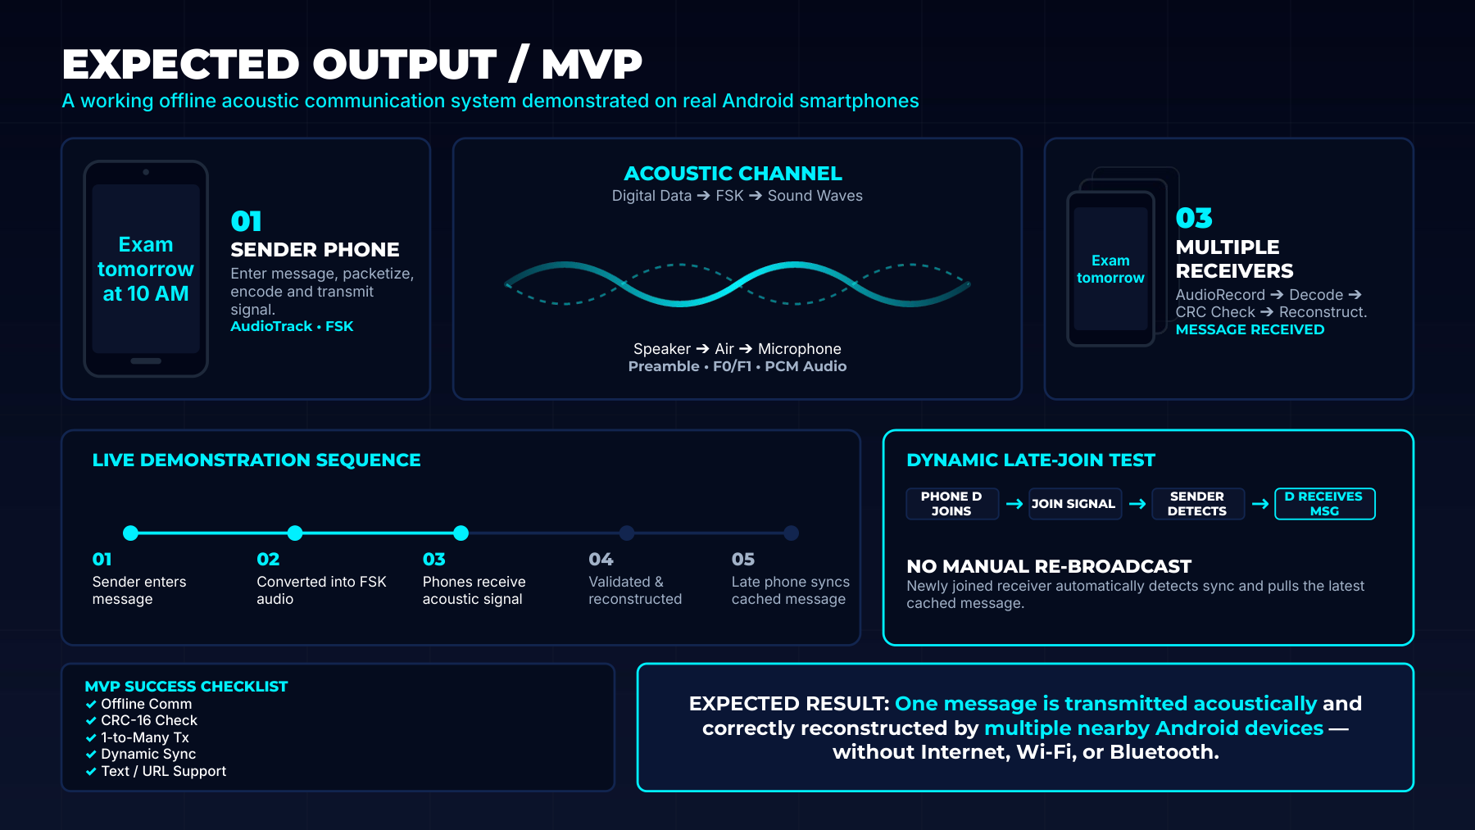

Slide 13
